Slide 1
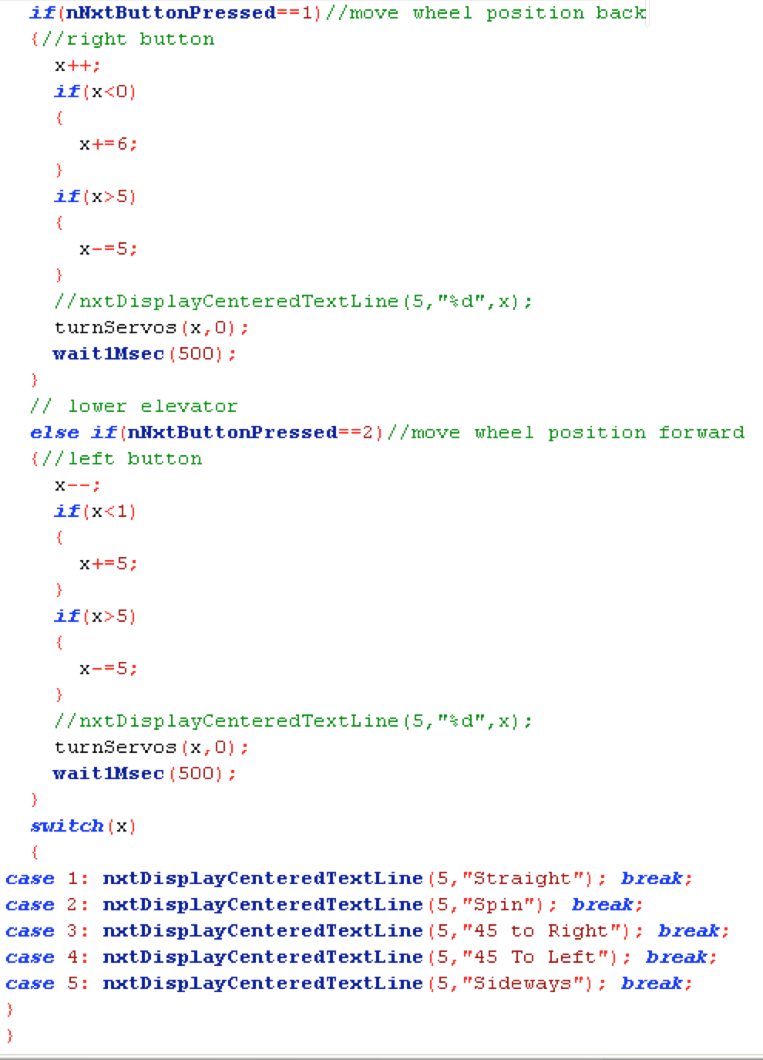
7350 Team Watt NXT, Edison New Jersey
Title
Page Number
Problem: Our wheels need to be occasionally tested and orientated in order for our swerve pods to be fully efficient and in maximum working capacity. This may have to be done between matches, so we need a convenient way to test the wheel pods.
Solution: Make a control software in order to quickly change and test the servo positions of the wheel-pod in order to test and manipulate the servos without the need of activating Tele-OP
Recorded by Vishal Sriram Sign Date
Time Start Stop

